Slide 1

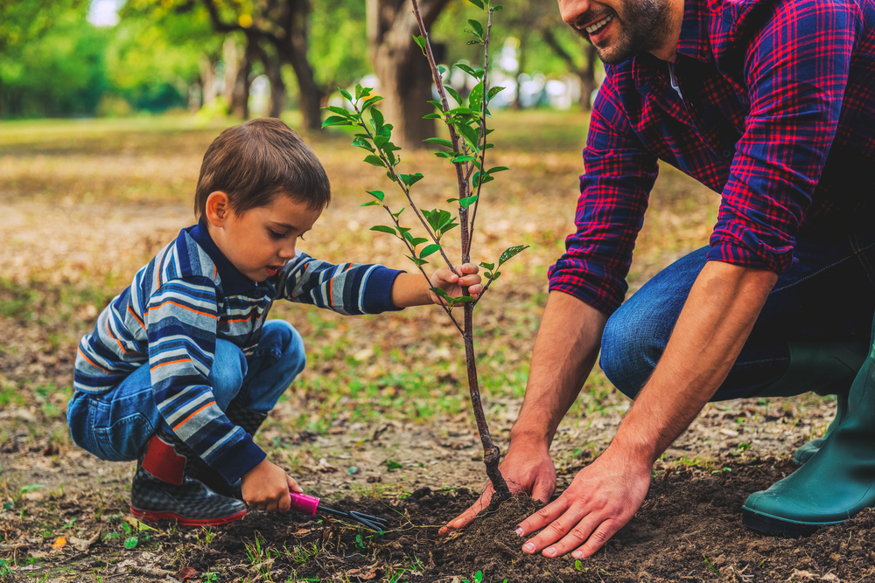

E-Tree Cambodia Environments
Advisor: Phan Chanraksmey
Team 3

Slide 2
Outline
Project introduces
Each member’s main task
Tools
Schedule
Points have/haven’t done
Learning/Experiences
Conclusion
Team
Demonstration

Slide 3
E-Tree
Project guides
Currently, We are looking for our environment which similar to down a little by little.
In our startup concept is going through to run up a business in cambodia,Particularly in our platform will be donated and stored for combodia citizen and public environment.
What? Why?

Slide 4
E-Tree
How Many
Main features
Data visualization
Authentication
Contact/about
Tree store
E-learning
Feedback
Donation
Events

Slide 5
HOw
Purchasing
Payment
Register
Donation
Payment/Trees
Login
Home
E-Learning
Access
Contact
Feedback
Manage account
Events
Join

Slide 6
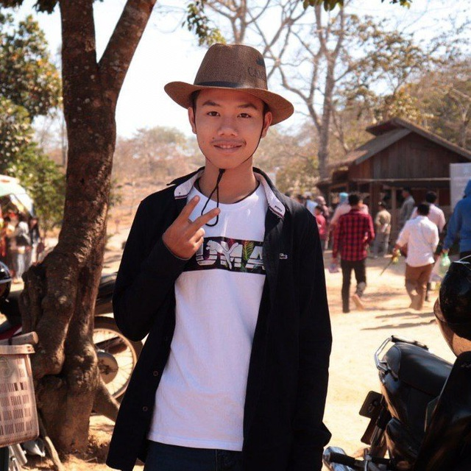
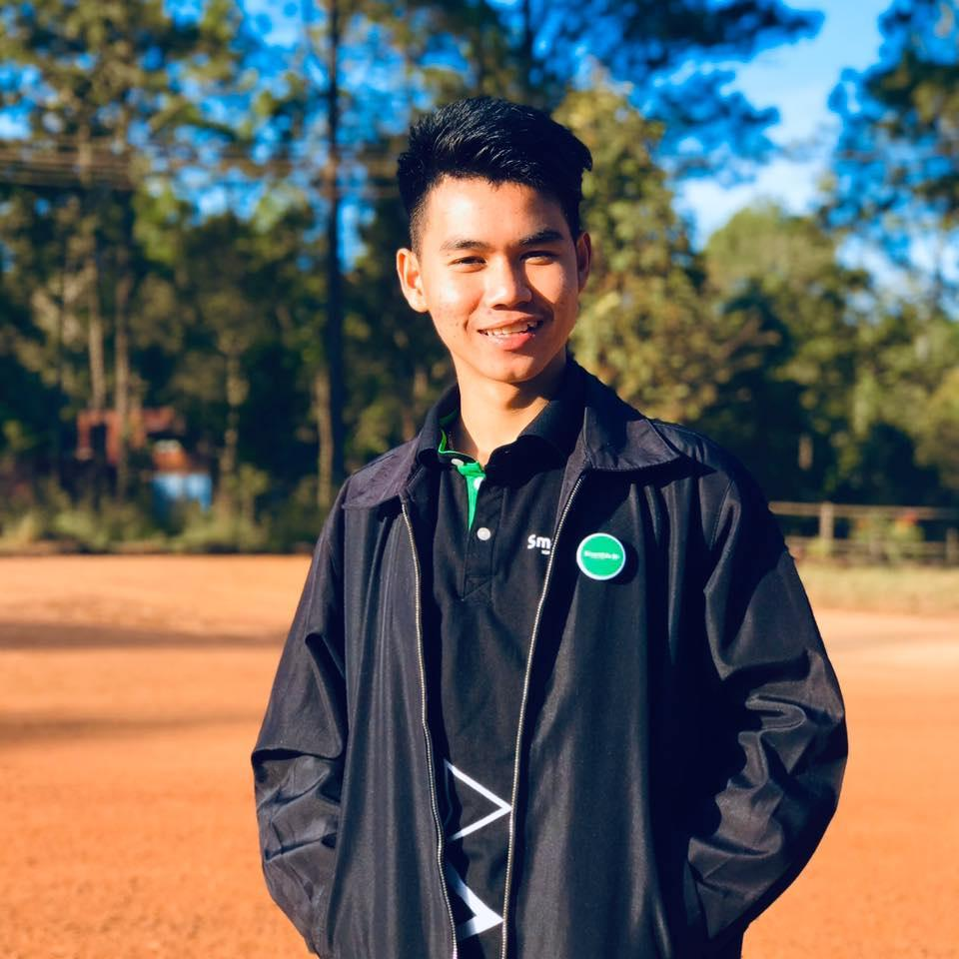
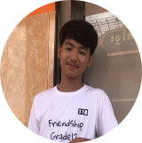
Member’s Task
Soeun Osaa
Srey Votana
Song Kemeng
Feedback/Feature
Authentication
Donation
Store
Database design
E-Learning
events
Slide
Contact/about
Use Case
Header
Report

Slide 7




Tools
GitHub
VS code
Adobe XD
Chrome

Slide 8
Schedule
Task/Weeks | 1 | 2 | 3 | 4 | 5 | 6
Learning/Team Up
Database Design
UX/UI Design
Implementation
Testing

Slide 9
Points have done
Data visualization
Authentication
Contact/about
E-Learning
Donation
Events
Stores

Slide 10




Point hasn’t done
User’s Payment

Slide 11
Learning / Experiences
Learnt
Experiences
PhP Laravel Composer OOP VCS
Team work Collaboration Researching Workflow

Slide 12



Conclusion
Web app
Tools
Time managed
Learning
Building a platform
New tools
Controlling the time in project
New knowledge

Slide 13
Our Teams
Soeun Ossa
Team-Leader
Srey Votana
Right Co-Leader
Song Kemeng
Left Co-leader

Slide 14
Thanks
Do you have any questions?
EtreeCambodia.com (+855) 23 999 333 WWW.E-Tree.com
Thanks for your attention

Slide 15
Demonstration
Time for indication
E-Tree

